Slide 1
Numerical Solver for the RBD Equations
Task 2

Slide 2
TEAM
Name | SEC | BN
Mohammed Ahmed Hassan Ahmed | 2 | 37
Ibrahim Thabet Allam | 1 | 1
Mohammed Hatem Mohammed Saeed | 2 | 39
Mohamed Hassan Gad Ali | 2 | 41
Mohammed Abd El Mawgoud Ghoneam | 2 | 43

Slide 3
Inputs
Initial Conditions
$$\left[u_{0} v_{0} w_{0}, p_{0} q_{0} r_{0}, φ_{0} θ_{0} ψ_{0}, x_{0} y_{0} z_{0}\right]$$
[𝒖_𝟎 𝒗_𝟎 𝒘_𝟎, 𝒑_𝟎 𝒒_𝟎 𝒓_𝟎, 𝝓_𝟎 𝜽_𝟎 𝝍_𝟎, 𝒙_𝟎 𝒚_𝟎 𝒛_𝟎 ]
Mass & Inertia
Forces
Moments
$$I= \left[\begin{matrix}I_{x} & I_{xy} & I_{xz} \\ I_{yx} & I_{y} & I_{yz} \\ I_{zx} & I_{zy} & I_{z}\end{matrix}\right]=\left[\begin{matrix}1 & −2 & −1 \\ −2 & 5 & −3 \\ −1 & −3 & 0.\end{matrix}\right]$$
𝑰= [■8(𝑰_𝒙&𝑰_𝒙𝒚&𝑰_𝒙𝒛@𝑰_𝒚𝒙&𝑰_𝒚&𝑰_𝒚𝒛@𝑰_𝒛𝒙&𝑰_𝒛𝒚&𝑰_𝒛 )]=[■8(1&−2&−1@−2&5&−3@−1&−3&0.)]
Mass = 15 kg
F = [10 5 9]
M = [10 20 5]

Slide 4
System of Equations
Kinetics Equations
Kinematics Equations
$$\left\{\dot{\begin{aligned}φ \\ \dot{\begin{aligned}θ \\ \dot{ψ}\end{aligned}}\end{aligned}}\right\}= \left[\begin{matrix}1 \\ 0 \\ 0\end{matrix} \begin{matrix}Sφ Tθ \\ Cφ \\ {Sφ}/{Cθ}\end{matrix} \begin{matrix}Cφ Tθ \\ −Sφ \\ {Cφ}/{Cθ}\end{matrix}\right]\left\{\begin{aligned}P \\ Q \\ R\end{aligned}\right\}$$
{(█(𝜙@(█(𝜃@𝜓 ̇ )) ̇ )) ̇ }= [■8(1@0@0) ■8(𝑆𝜑 𝑇𝜃@𝐶𝜑@𝑆𝜑⁄𝐶𝜃) ■8(𝐶𝜑 𝑇𝜃@−𝑆𝜑@𝐶𝜑⁄𝐶𝜃)]{█(𝑃@𝑄@𝑅)}
$$F_{x}=m(\dot{u}+qw−rv)$$
𝐹_𝑥=𝑚(𝑢 ̇+𝑞𝑤−𝑟𝑣)
$$F_{y}=m(\dot{v}+ru−pw)$$
𝐹_𝑦=𝑚(𝑣 ̇+𝑟𝑢−𝑝𝑤)
$$F_{z}=m\left(\dot{w}+pv−qu\right)$$
𝐹_𝑧=𝑚(𝑤 ̇+𝑝𝑣−𝑞𝑢)
$$L= \dot{H_{x}}+{qH}_{z}−rH_{y}$$
𝐿= (𝐻_𝑥 ) ̇+〖𝑞𝐻〗_𝑧−𝑟𝐻_𝑦
$$M= \dot{H_{y}}+{rH}_{x}−pH_{z}$$
𝑀= (𝐻_𝑦 ) ̇+〖𝑟𝐻〗_𝑥−𝑝𝐻_𝑧
$$N=\dot{H_{z}}+pH_{y}−qH_{x}$$
𝑁=(𝐻_𝑧 ) ̇+𝑝𝐻_𝑦−𝑞𝐻_𝑥
$$\left\{\dot{\begin{aligned}X \\ \dot{\begin{aligned}Y \\ \dot{Z}\end{aligned}}\end{aligned}}\right\}= \left[\begin{matrix}C_{θ}C_{ψ} & S_{φ}S_{θ}C_{ψ}−C_{φ}S_{ψ} & C_{φ}S_{θ}C_{ψ}+S_{φ}S_{ψ} \\ C_{θ}S_{ψ} & S_{φ}S_{θ}S_{ψ}+C_{φ}C_{ψ} & C_{φ}S_{θ}S_{ψ}−S_{φ}C_{ψ} \\ −S_{θ} & S_{θ}C_{θ} & C_{φ}C_{θ}\end{matrix}\right]\left\{\begin{aligned}u \\ v \\ w\end{aligned}\right\}$$
{(█(𝑋@(█(𝑌@𝑍 ̇ )) ̇ )) ̇ }= [■8(𝐶_𝜃 𝐶_𝜓&𝑆_𝜙 𝑆_𝜃 𝐶_𝜓−𝐶_𝜙 𝑆_𝜓&𝐶_𝜙 𝑆_𝜃 𝐶_𝜓+𝑆_𝜙 𝑆_𝜓 @𝐶_𝜃 𝑆_𝜓&𝑆_𝜙 𝑆_𝜃 𝑆_𝜓+𝐶_𝜙 𝐶_𝜓&𝐶_𝜙 𝑆_𝜃 𝑆_𝜓−𝑆_𝜙 𝐶_𝜓@−𝑆_𝜃&𝑆_𝜃 𝐶_𝜃&𝐶_𝜙 𝐶_𝜃 )]{█(𝑢@𝑣@𝑤)}

Slide 5
Outputs
States
$$\left[u v w, p q r, φ θ ψ, x y z\right]$$
[𝒖 𝒗 𝒘, 𝒑 𝒒 𝒓, 𝝓 𝜽 𝝍, 𝒙 𝒚 𝒛]
(states values over the specified time span )

Slide 6
Code Strategy
6DOF
Initial Conditions
Forces
RBD Solver
Moments
Inertia & Mass
Solving
Solving state by state using RBD Solver
Appling RK4 in order to evaluate the next state.
Evaluation of 12 equation for given set of inputs
Verifying
Using Simulink (equations)
Using ode45 (integration)

Slide 7
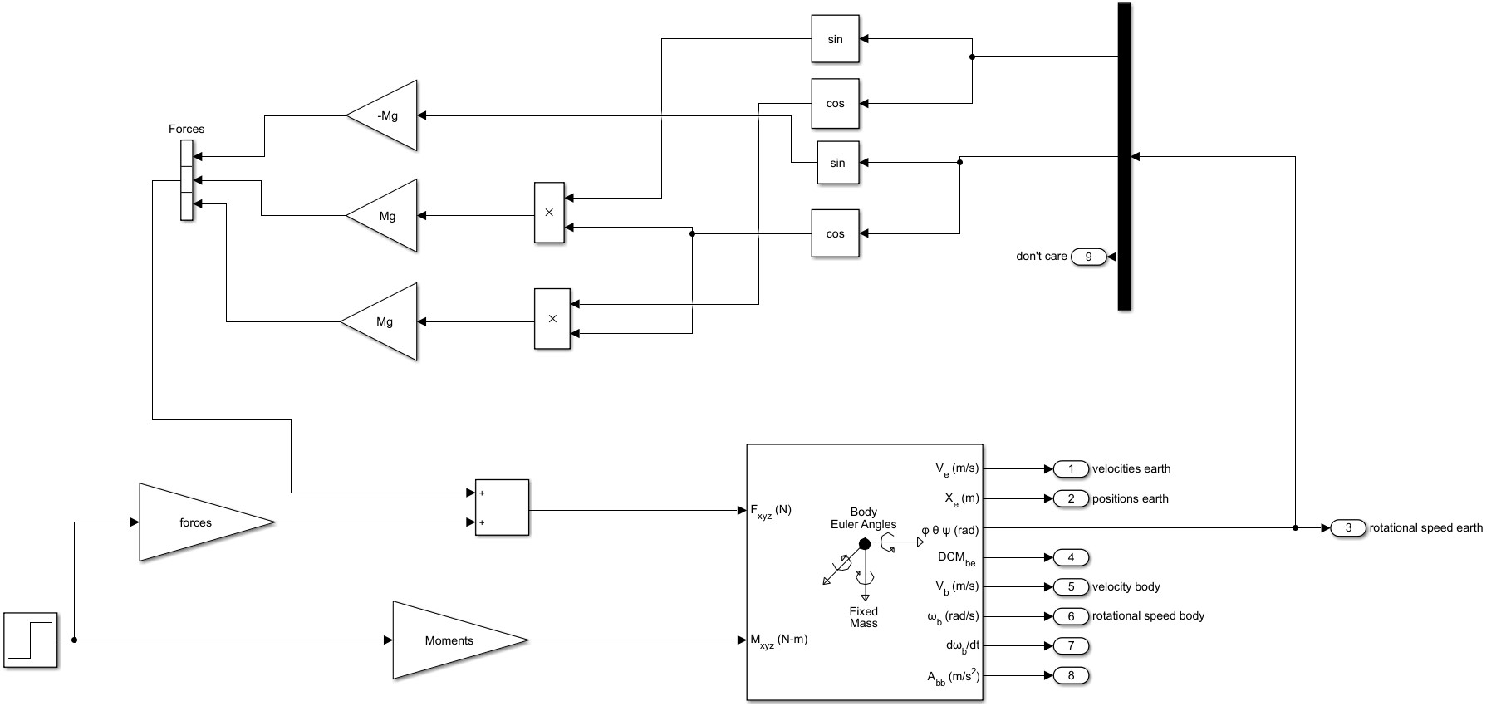
Simulink

Slide 8
Results & Verifying

Slide 9
Results & Verifying

Slide 10
Results & Verifying

Slide 11
Results & Verifying

